Slide 1
Household Debt in Korea
Jongsung Kim
Bryant University
Smithfield, Rhode Island

Slide 2
Definitions of Household Debt
Household credit (가계신용) - underestimate
Sum of household loans and purchases on credit
963.8 trillion won in 2012 (853.7 billion USD at 1 USD = 1,129 won as of June 12, 2013)
Individual Financial Debt (개인금융부채) - BOK Money Flow Table
Also includes debt incurred by the self-employed and non-profit organization in addition to households.
1158.8 trillion won in 2012 (1.026 trillion USD)
LTV: Loan to Value ratio (the percentage of a consumer's monthly gross income that goes toward paying debts.
DTI: Debt to Income ratio (ratio of a loan to the value of an asset purchased)

Slide 3
Korea at a glance
Population (2012) | 50.004 million
GDP per capita (2012) | 22,708 USD
Household Income (2013, 1/4) | 4,192,558 won (3,710 USD)
Household expenditure (2013, 1/4) | 3,344,597 won (2,962 USD)
Household debt (2012) | 963.8 trillion won (853.7 trillion USD)
Total households (2012, 08) | 17,951 thousand
Average household debt (2012) | 52.9 million won (46,823 USD)
Unemployment rate (2013, 05) | 3.0%
Employment rate (2013, 05) | 60.4%
CPI growth rate (2013, 05) | 1.3%
Life expecantcy (2011) | 81.2 years (84.5 for female, 77.7 for male)
% of Population over 65 (2012) | 12.2%

Slide 4
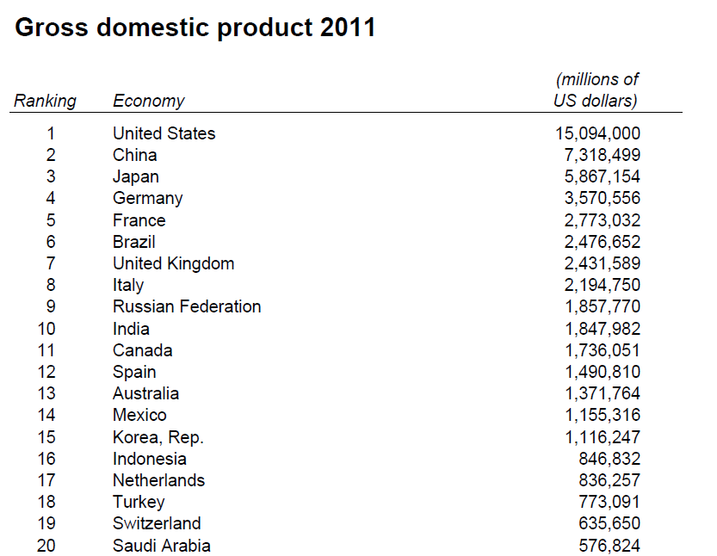
Source: World Bank http://databank.worldbank.org/data/download/GDP.pdf (As of April 15, 2013)

Slide 5
GDP and grow rate

Slide 6
F1 Trends of Household Debt in Korea

Slide 7
In comparison, the US household debt
fell to $11.2 trillion in the 2013, ¼ compared with a peak of $12.7 trillion in the 2008, ¾.
Mortgage debt led the decline, falling to $7.93 trillion from $8.03 trillion.
Credit card balances decreased $19 billion to $660 billion.
Total student debt rose to $966 billion
http://www.newyorkfed.org/householdcredit/

Slide 8
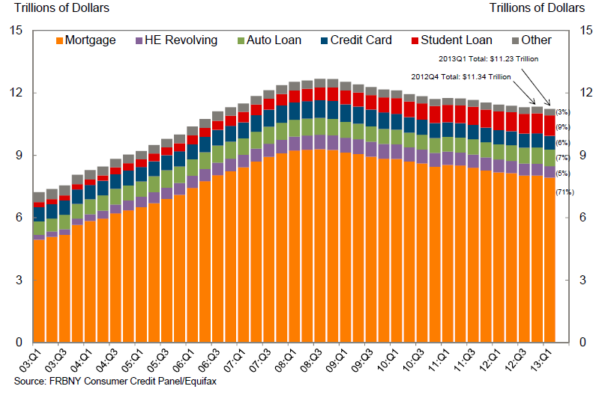
Total debt balance and its composition in the U.S.

Slide 9
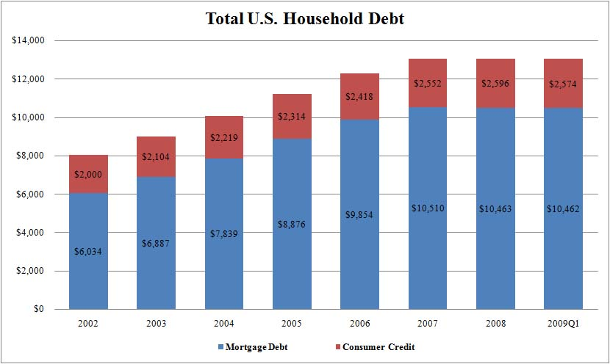

Slide 10
Although the growth rate of the debt declined from 11.8% in 2006 to 5.2% in 2012, the amount of debt has increased 58.7%.
2000 to 2012 average, 12.1%
2003 to 2012 average , 7.6% (NGDP growth rate, 7.5%)
1997 to 2012 average, 11.3%

Slide 11
F2 Share of household debt to Disposable Income

Slide 12
Household debt in Korea in 2012
963.8 trillion won (853.7 billion USD at $1=1129 won)
household loan of 905.9 trillion won (5.2% increase)
purchase on credit of 57.9 trillion won (3.1% increase)
The ratio of household debt to household Disposable Income (DI) reached 136%, the highest since 2003.
Household debt per capita reached 74% of GDP per capita.
According to OECD statistics, which also include the financial debt of non-profit organizations, the ratio of Korea’s household debt to DI to 150.8 percent in 2010 from 116 percent in 2004 and 139 percent in 2007. (11%)

Slide 13
In 2010, the average debt-disposable income ratio of 25 OECD countries for which data was available was 128.8 percent.
In comparison, the average debt-disposable income ratio in the U.S. was 122.5 percent in 2010, the lowest since 2003 and a 13.9 percentage point decline from its peak (136.4) in 2007
The ratio of household debt to GDP reached 81 percent in 2010, higher than the OECD countries’ average of 73 percent.
On April 22, 2013, BOK Governor Kim Choong-soo remarked that “The nation’s household debt reached a limit” in his report to the Korean National Assembly.

Slide 14
F3 Growth rates of CPI, personal DI and household debt
While the growth rate of personal DI has been greater than that of CPI since 2000, the growth rate of household debt has exceeded that of personal DI since 2005, presenting evidence of households’ economic hardship.

Slide 15
F4 Share of debt-holding households, average debt and share of total debt by income quintiles in 2012

Slide 16
Transmission Mechanism
Excessive Household Debt
+
International Economic Shocks
Unemployment, Income Decline
Interest Rate Rise
Asset Price Decline
Rise in the Household Debt Burden
Negative Impact on Consumption
Worsening financial companies
Negative impact of Investment
Bankruptcy of financial companies
Acceleration in the Economic growth slowdown
Source: Kang, Dong-soo, KDI (2012)

Slide 17
The household debt in Korea will affect the Korean economy in the following ways.
First, the rising household debt will reduce saving and investment which can slow down economic growth and potential economic growth rate. Also the lower savings rates can make Korean economy more dependent on foreign capital and susceptible to the fluctuations in the global financial markets.
Second, as the household debt rises, private consumption and demand in the housing market will decline. This will also retard economic growth.
Third, the mounting household debt may lead to insolvency when debtors are unable to repay their loans on time, creating instability in the financial system.

Slide 18
Fourth, the rising household debt can be transferred to government debt. The government may need to step in and increase its subsidies or transfer payments, which will correspondingly raise the government debt.
Fifth, when the household debt is rising or has reached a critical point, the government will not be able to freely use interest rate policy to stabilize the economy to control inflation by increasing interest rates.
Sixth, the rising household and government debt can make the Korean economy more vulnerable to exogenous shocks.
Will lead to insufficient foreign currency reserve due to capital flight, and fluctuations in exchange rates.
Lastly, the rise of household debt can also exacerbate the income inequality, creating uncertainty and instability in the Korean society.

Slide 19
Savings
A major consequence of Korea’s rising household debt is the decline in household savings.
Korea’s household savings rate declined significantly after the Asian financial crisis from over 20% in the mid-1990s to a mere 2.7% in 2011.
This is only half of the average household savings rate of 5.3% among the 23 OECD countries where data was available. For the U.S., it was 4.2% in 2011.
This sudden decline of Korea’s household savings rate [New Zealand (2.3%) and Japan (2.9%)] is unprecedented in terms of the time period of the overall drop in savings among the OECD countries.

Slide 20
The average household savings rate in Korea from 2000 to 2010 was 4.7% percent which is less than one-fourth of the average savings rate (19.8%) from 1990 to 1999.
The savings rate in Korea especially plummeted after two periods of economic distress: (slower growth of labor share, aging population)
From 1998 to 2002 after the Asian financial crisis when the savings rate dropped from 21.6% to 0.4% (generous social contribution → more consumption)
From 2004 to 2008 after the credit card crisis, the savings rate declined from 8.4% to 5.8% (low interest rate → real estate speculation)

Slide 21
Why did the household debt in Korea rise?
Accommodative monetary policy
Lending practice of financial sectors
Booming real estate market
Untimely policy responses of the regulating authorities
Expansion of real estate ownership of baby boomers, born between 1955 and 1963.

Slide 22
Reasons for the rise in Korea’s Household Debt
First, the policy change at the end of the 1990s created the liquidity effect, marked by an excess liquidity in 2003. After the Asian financial crisis in 1997, the target price level for price stabilization was set too high and this led to a supply of excess liquidity.
The accommodative monetary policy helped to maintain the interest rates at a low level after the financial crisis.

Slide 23
Second, the Korean government at the end of 1997 adopted the policy to encourage the use of credit cards to boost the economy through raising consumption and increasing the transparency of financial transactions.
This benign intent, however, led to a rise in credit card use and raised the competition among credit card companies that over-issued credit cards to non-qualified applicants.
Eventually, this led to the credit card crisis at the end of 2003 when the delinquency rate of credit cards rose as the result of declining household income and repayment ability, worsened by the delayed recovery in Korean economy.

Slide 24
Third, the artificially created low interest rates induced large credit creation. The boom in the housing market linked with low interest rate also helped the household debt to expand.
The rising value of real estate, especially in residential housing, induced people to borrow heavily to purchase more real estate in expectation of profits.
For example, the expansion of real estate ownership by Korean baby boomers, who were born between 1955 and 1963 and comprise one fifth of the population, is cited as a reason for the rise of household debt in the 2000s.

Slide 25
Fourth, after the 1997 Asian financial crisis, Korean financial institutions without having appropriate risk management system such as credit appraisal shifted their focus from lending credit lines to firms to household loans, as firms became more risk averse.
This was facilitated with the continuation of low interest rates from the accommodative monetary policy.
What also fueled the expansion of household debt were loose regulations and the lack of systemic accountability, which contributed to the inability of Korean financial regulators to adequately supervise the banking sectors and also paved the way for other unregulated non-banking sectors that can freely lend for-profit loans.

Slide 26
Realty invincibility
The debtors can acquire additional loans as their portfolio increases; this is accomplished through additional acquisition of assets (collateral) with an increased valuation, which would have accumulated on the original collateral due the constant and intense real estate market speculation.
The banking sector mortgage loan balance rose significantly.
Mortgages and home equity loan program in Korea typically have a few years of interest only repayment period built in at the beginning during which debtors pay only the interests on the loan until the end of the designated term at which time the payment of the principal must be paid in full. (balloon payment, financially crippling)

Slide 27
The rising value of real estate also contributed to the expansion of real estate related project financing (PF) loans.
It was reported that as of March 2009, the volume of PF by financial institutions as a whole stood at 81.7 trillion won.
Financial institutions concentrated on the home equity loans, for which the risk management is easier since the loan only occurs with secure collateral.
Since the housing price depends on the structural changes in the housing market, the lending practice concentrating on home equity loans creates structural vulnerability.
The recent housing market stagnation created some pessimism giving less credence to the past trend of a robust housing market.

Slide 28
A BOK report..
34.7% of the sample households replied that the price of real estate they owned declined (8.2% for significant decline).
The percentage of households that replied that the value of real estate they owned rose was 24.4% (5.1% for significant rise).
Not surprisingly, the household debt problem is expected to exacerbate as 58.9% of the households replied that they are having a difficulty in their daily lives due to the repayment of principal.

Slide 29
Non-banking financial institutions
Especially vulnerable groups are the low-income class with bad credit, debtors with multiple loans and small-scale self-employed merchants whose debt structure is worsening.
As the result of stricter regulations on loan appraisal, those with relatively lower credit ratings are forced to take out loans from the non-banking financial institutions that would charge higher interest rates.
A 2012 FSS report:
As the banks shifted their lending practices to those with collaterals categorized as lower risk assets, the share of loans extended to borrowers with low credit ratings (credit ratings are below category 7), declined from 14.5% in 2008 to 11.4% in 2012.
The report also showed that the share of low-income class in taking loans from the non-banking sector rose from 43.2% in 2008 to 47.3% in 2012.

Slide 30
The strength of the supervision was not sufficient to rein in the expansion of household debt as it only focused on the LTV-oriented regulation and the different regulation systems for different financial sectors.
Accordingly, in the early stage of increase in housing prices, the regulation centered on the LTV failed to effectively rein in the expansion of household debt.
The failure of sequentially implementing the DTI regulation after the LTV regulation, due to the resistance from the financial sector and arguments against the use of DTI as it is an excessive policy intervention, is also regarded as a reason that the exploding rise of household debt was not preemptively suppressed.

Slide 31
Loan to Value (LTV) ratio and Debt to Income (DTI) ratio
The LTV ratio is the most effective policy tool that the financial regulation authority can use to manage risks associated with the fluctuation in the value of real estate.
The LTV ratio can be underestimated if it does not properly account for the “Jeon Se (전세)” deposit, where substantial deposit (54.14% in 2012) is required to lease a property. (school district)
Currently, in Seoul Metropolitan Area, the LTV ratio is 50% on houses of price lower than 600 million won and 60% on others. (80% is low LTV in the US). The DTI ratio is 50% in Seoul, and 60% in Seoul Metropolitan Area.
Even the DTI-oriented regulation, which was fully implemented by the end of 2006, had little desired effect, as the regulations had to be adapted to accommodate the global financial crisis at that time.

Slide 32
Remedies by the Korean Government
Many policies were implemented with a varying degree of success to address the household debt problem.
“Comprehensive measures to induce a soft landing for household debts” – 가계부채 연착륙 종합대책 - in June 2011
More fixed interest loans and adjustment of repayment period
“Supplementary rules for non-banking household loan activities” – 제2금융권 가계대출 보완대책 - in February 2012
Regulating non-banking lending institutions (Mutual Savings Banks, Insurance companies)
Loan-Deposit ratio (예대율) for mutual savings banks at 80% maximum

Slide 33
National Happiness Fund (NHF)
Presidential candidate Park Geun-hye made a pledge to launch a National Happiness Fund (NHF)—a form of debt relief fund—of 18 trillion won (USD 17 billion) to ease the debt burden of the low-income class, in particular the 3.22 million people who are unable to service their debts.
NHF was launched on March 29, 2013.
It gives debtors more time to repay their loans and reduce their interest rates for a limited time.
In particular, loans with interests in excess of 20% were targeted to reduce their rates to 10% range for loans taken out from financial institutions that charge high interests, sometime over 20%.
Those who had been diligently paying off debts for the six months leading to end of February 2013 may be entitled to this debt relief program with maximum loan amount of 40 million won.

Slide 34
FSC Press Release on NHF
http://m.fsc.go.kr/eng/01Sub/engPressRelease.do?FLAG=VIEW&CPAGE=1&NUM=28010

Slide 36
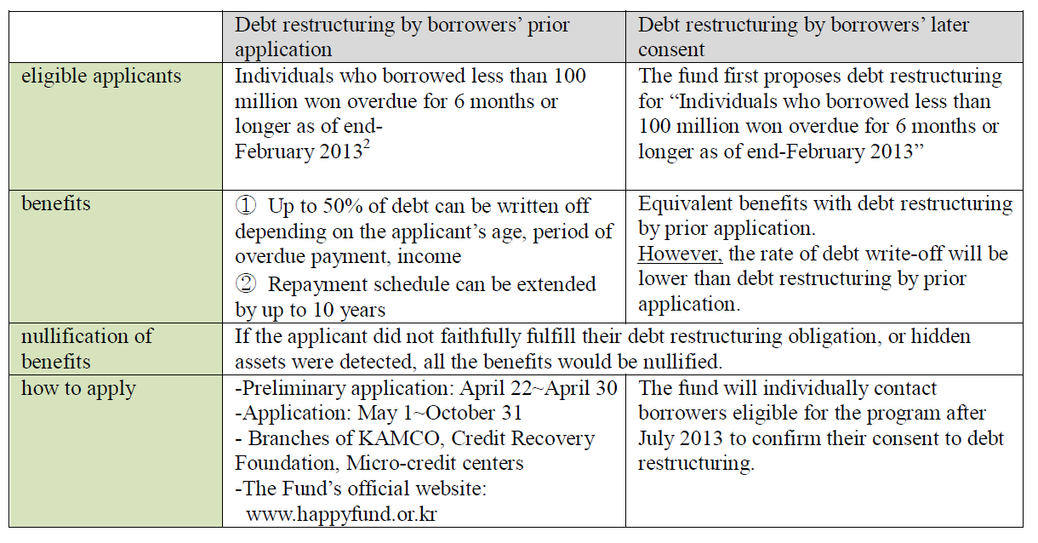
http://m.fsc.go.kr/eng/01Sub/engPressRelease.do?FLAG=VIEW&CPAGE=1&NUM=28010
FSC Press Release on NHF

Slide 38
Problems
This plan can create a moral hazard as the government will help the borrowers repay their debts.
Funding sources for the plan are too small and it is applicable to only a minority of people who took out institutional loans.
The NHF is a form of political populism that threatens the market order and creates conflicts among debtors who have sincerely tried to pay their debts.
The use of bankruptcy court or rehabilitation procedure may be more advantageous than the use of NHF.
Individuals who are classified as the basic livelihood security recipients who eke out a bare existence from day to day rarely have the ability to repay.

Slide 39
The long redemption period of 10 years was also pointed out as an obstacle to a success of the NHF.
If a NHF beneficiary fails to meet the terms stipulated by the NHF for only a year after successful compliance for 9 years, the efforts would turn out to be in vain.
While the NHF is not the fundamental solution to the household debt problem, the fund expects to ease some of the acute debt burden of the least privileged.
For this reason, the NHF should be understood in light of social security and rehabilitation rather than credit amnesty.

Slide 40
4.1 (April 1) Real Estate Measures
A policy to stabilize and boost real estate transaction which will in turn stimulate the economy.
This measure along with the lower interest rates (2.5%) already began to boost the housing market.
As of May 20, 2013, the market price of high-rise residences apartments has been increasing in the last 8 consecutive weeks in the capital regions and 11 consecutive weeks in the non-capital region.
The “4.1 Real Estate Measure” is expected to raise home-equity loans and household debt.

Slide 41
April 30 amendment to the Tax Reduction and Exemption Control Act
Exempts the transfer income tax for a newly-built housing unit for a household under the value of 600 million won or 85 square meters, acquired from 4/1 to 12/31, 2013, if the unit is to be transferred within 5 years of acquisition.
Proponents: This amendment is a desperate measure to normalize real estate transactions and this limited-time measure aims to facilitate the disposal of housing for the poor and the middle/low-income class. (No change for DTI & LTV except first-time home buyers)
Opponents: The bill is inconsistent; they favor smaller housing units that meet space requirements in affluent areas over the bigger units that are slightly over the price restrictions in non-capital areas that more urgently need assistance for this type of bill.

Slide 42
Recommendations
The remedies to alleviate the problem should be found in more fundamental areas in Korean economy and society.
First, job creation should be considered especially for the least privileged.
Create decent jobs
Better employment security
Employment training programs.
The workers in the non-regular sectors (비정규직) need special assistance in finding employment.
Despite the low unemployment rate of 3%, “the quality of new jobs being created is declining” and many of them are concentrated in the service sector and are on short-term contract basis.

Slide 43
Second, policy attention for both debtors and lenders.
For debtors, more financially supported policies such as micro finance and petty loans for the low-income class are needed within the range that does not create or minimizes moral hazard.
Adjust the loan structures by flexibly transferring high-interest debt into lower-interest debt as well as extend the repayment period.
Opening more branches dealing with these loans, offering extended business hours, and disseminating loan application information more effectively (such as setting up a call center for credit management counseling) are recommended.
Policies, such as the LTV and DTI regulations, should also be implemented in timely manner to guide all forms of lenders to be careful not to overextend loans.
Finally, all these programs must be monitored and data should be collected to see if these programs are actually working.

Slide 44
Q & A
Thank you.

