Slide 1
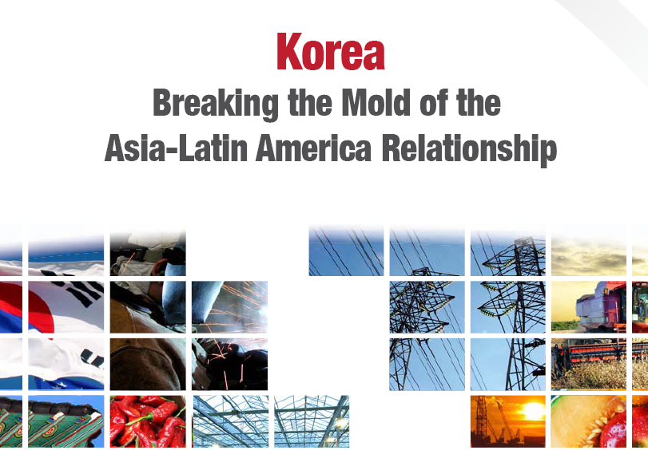
Mauricio Mesquita Moreira
Principal Economist
Trade and Integration Sector

Slide 2
Outline
Behind the booming trade: drivers, gains and concerns
Trade costs: still uncomfortably high
Investment and cooperation: the balancing act
Summing up: breaking the mold

Slide 3
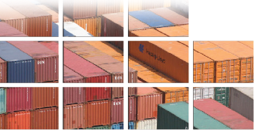
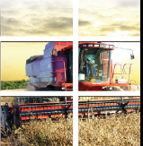
Behind the booming trade

Slide 4
Korea-LAC trade has grown fast since the early 1990s
Notes:
4

Slide 5
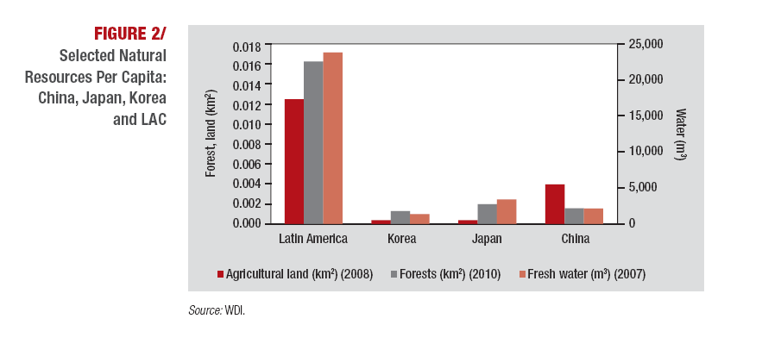
…driven by a strong complementarity of endowments and more complementary manufacturing sectors.
Korea’s high per capita income offers opportunities to add value to food and mining products and the greater high tech specialization of its industry suggest more opportunities for intra-industry trade and lower risks of trade frictions.
Notes:
5

Slide 6
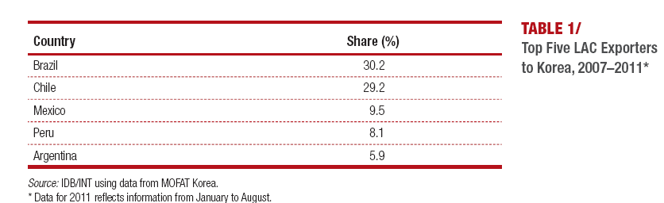
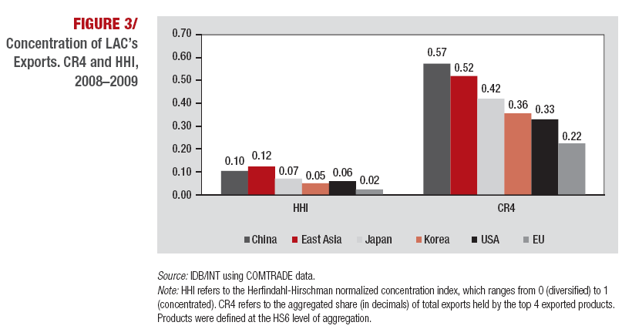
But the boom has been concentrated in few LAC countries and products. Concentration, though, is lower than in trade with China.

Slide 7
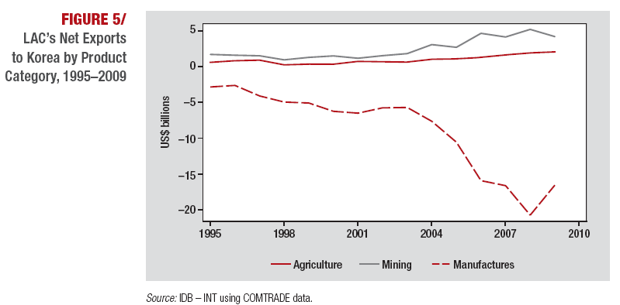
And the bulk of trade is based on the “commodities-for-machines” model…

Slide 8
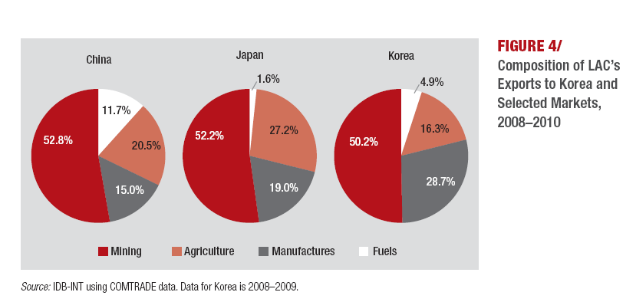
…but LAC’s exports are more diversified and sophisticated than in the trade with China.

Slide 9
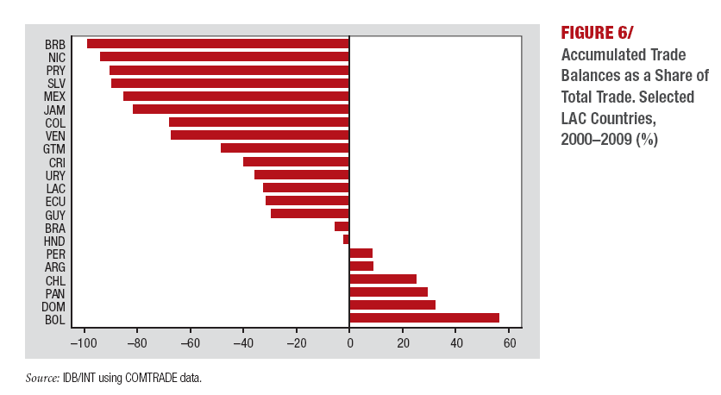
The growing trade imbalances can be a source tension

Slide 10
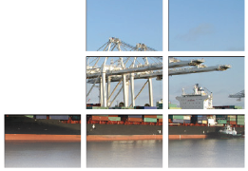
Trade Costs: still uncomfortably high

Slide 11
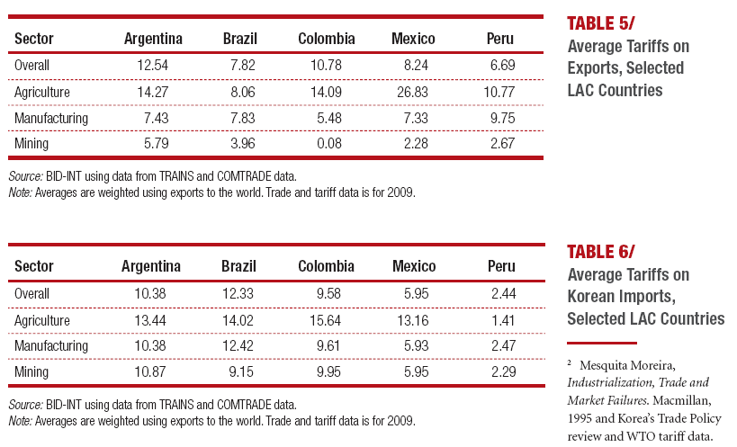
Tariffs and non-tariff barriers have come down, but they are still a barrier to a more diversified trade.

Slide 12
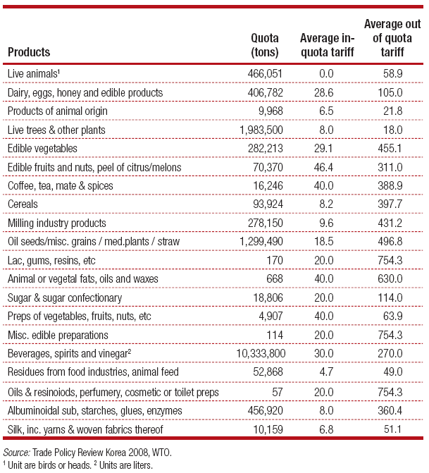
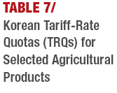
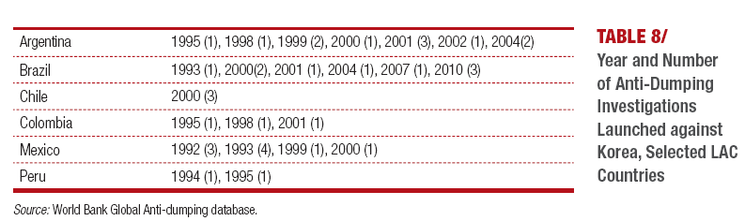

Slide 13
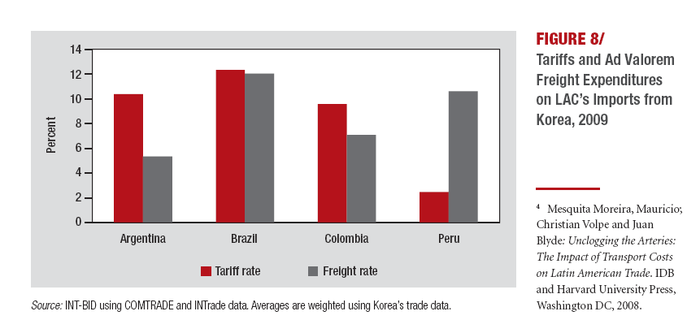
…and are compounded by high transport costs.

Slide 14
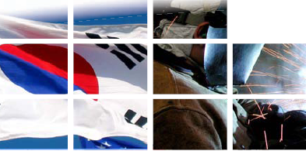
Investment and cooperation:
Strengthening the other pillars

Slide 15
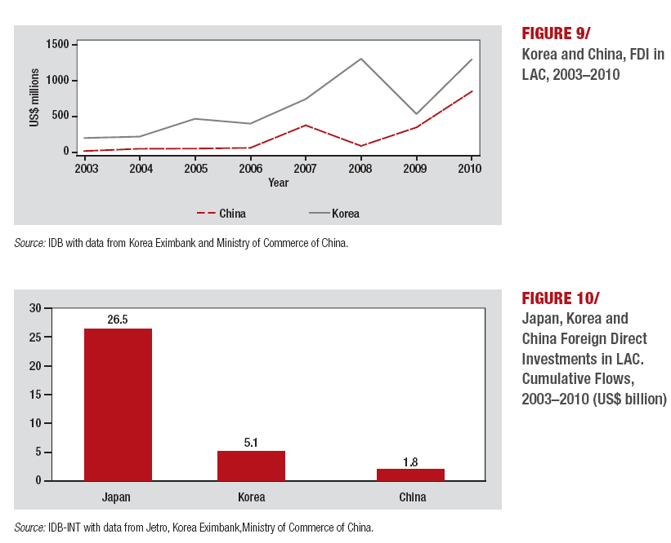
Investments are following trade,
but only on the Korean side

Slide 16
Heavily concentrated in Brazil, Mexico and Peru
  it has a important manufacturing component like Japan and unlike China

Slide 17
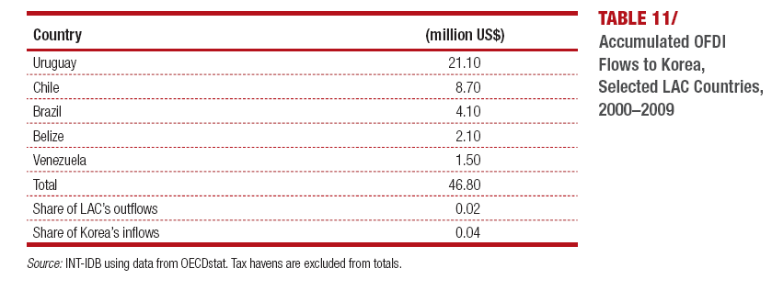
LAC investment is still a trickle
Too limited to have an impact on trade

Slide 18
Cooperation is also on the rise,
but would benefit from a stronger institutional framework

Slide 19

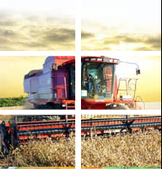
Conclusions

Slide 20
Breaking the mold
LAC’s booming trade with Korea is a powerful reminder that the regions’ opportunities in Asia are not just limited to China.
as in the case with China, resources complementarity has been, and is bound to be for the foreseeable future, the main driver for bilateral trade and investments. However, there are also strong fundamentals for this relationship to go beyond the canonical Asia-LAC model of commodities for machines.
However, the consolidation of these promising trends will hinge critically on the governments’ ability to bring down the remaining barriers to trade, still significant on both sides of the relationship
The figures on bilateral investment are another good reason to believe that LAC and Korea can go beyond the canonical model. Korea’s investments have been following exports closely and with a level of diversification not seen in other LAC-Asia relationships. It has not been just about natural resources.
the well of opportunities would not be entirely exploited without efforts to boost cooperation in public policy issues. There is already a critical mass of initiatives in place, but more biding and better documented agreements, to allow for the evaluation of the results, would increase the efficiency of these initiatives.

